Slide 1






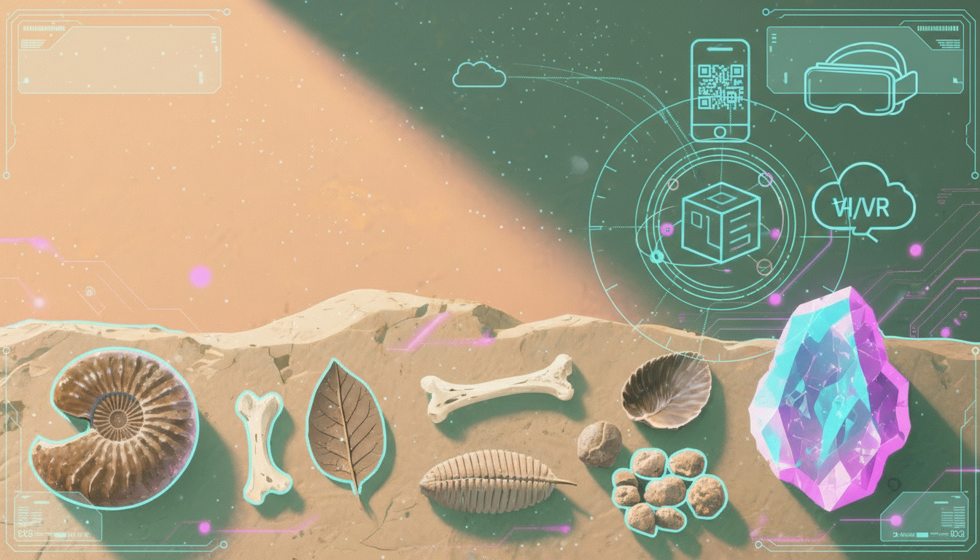




Bridging
Realities
An Immersive AR & VR Powered Museum Experience
Step Into the Past with Knowledge, Wonder, and Interaction
Presented by
Group 25-26J-416

Slide 2











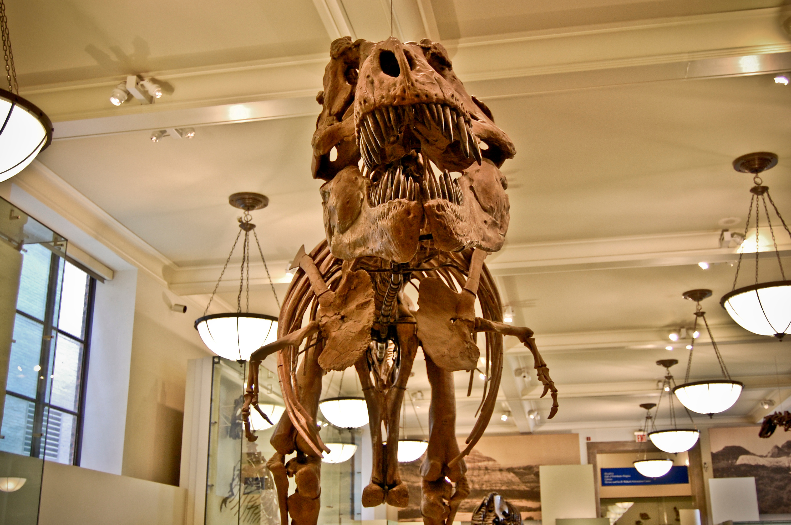
Bridging Realities
01/16
Our
Team
Mr.Aruna Ishara Gamage
Mr.Nushkan Nizme
Supervisor
Co-Supervisor
We’re excited to bring history, technology, and discovery together.
Ashen Tennakoon
Sherwin Li
Imalki Pinto
Ruwani Pradeepa
IT22361004
IT22135520
IT22149558
IT22033482

Slide 3

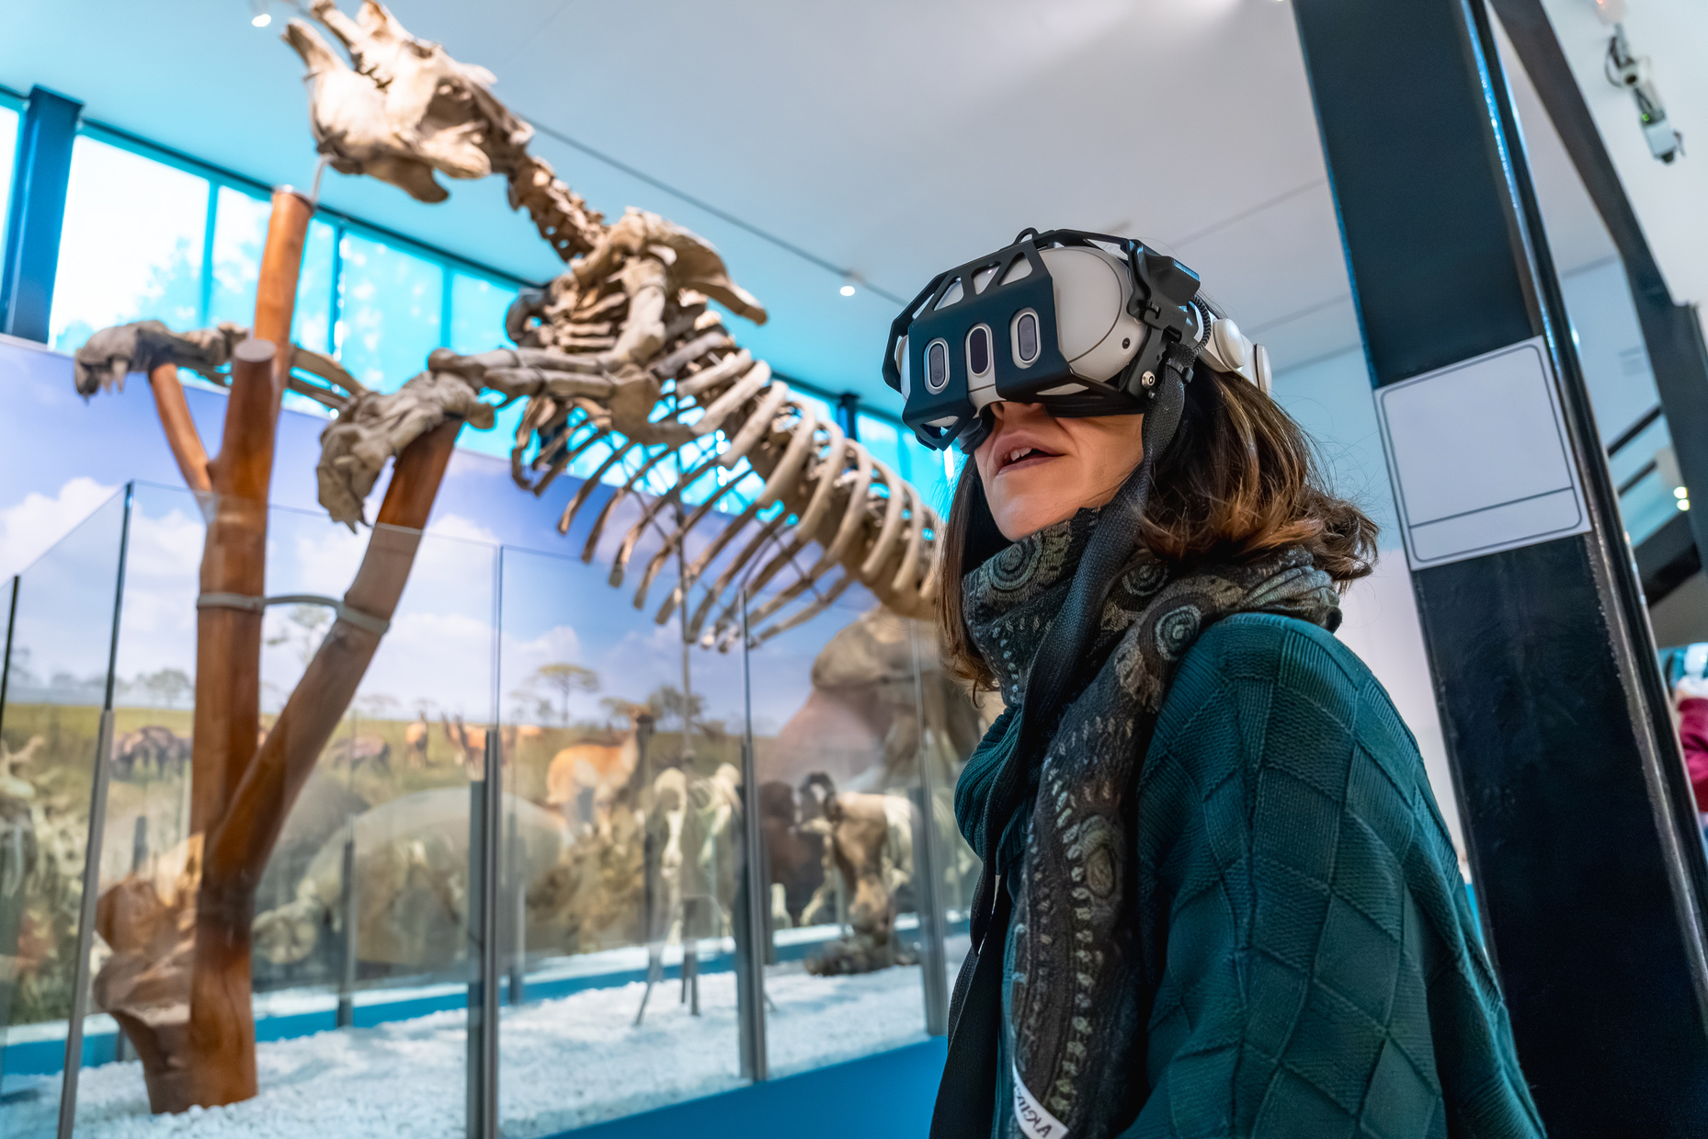
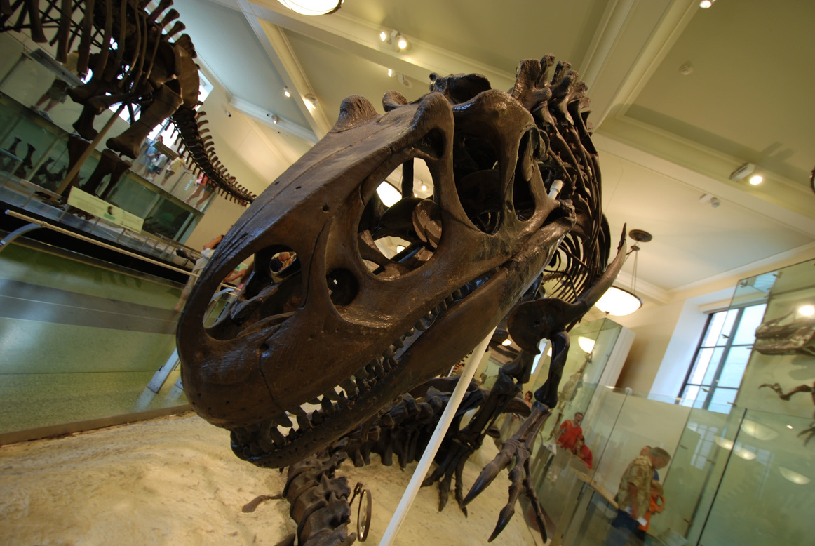
25-26J-416
02/16
Research
Question ?
How do immersive technologies (VR, AR, and mixed environments) enhance visitor engagement, learning outcomes, and educational accessibility in museum contexts compared to traditional static displays?

Slide 4

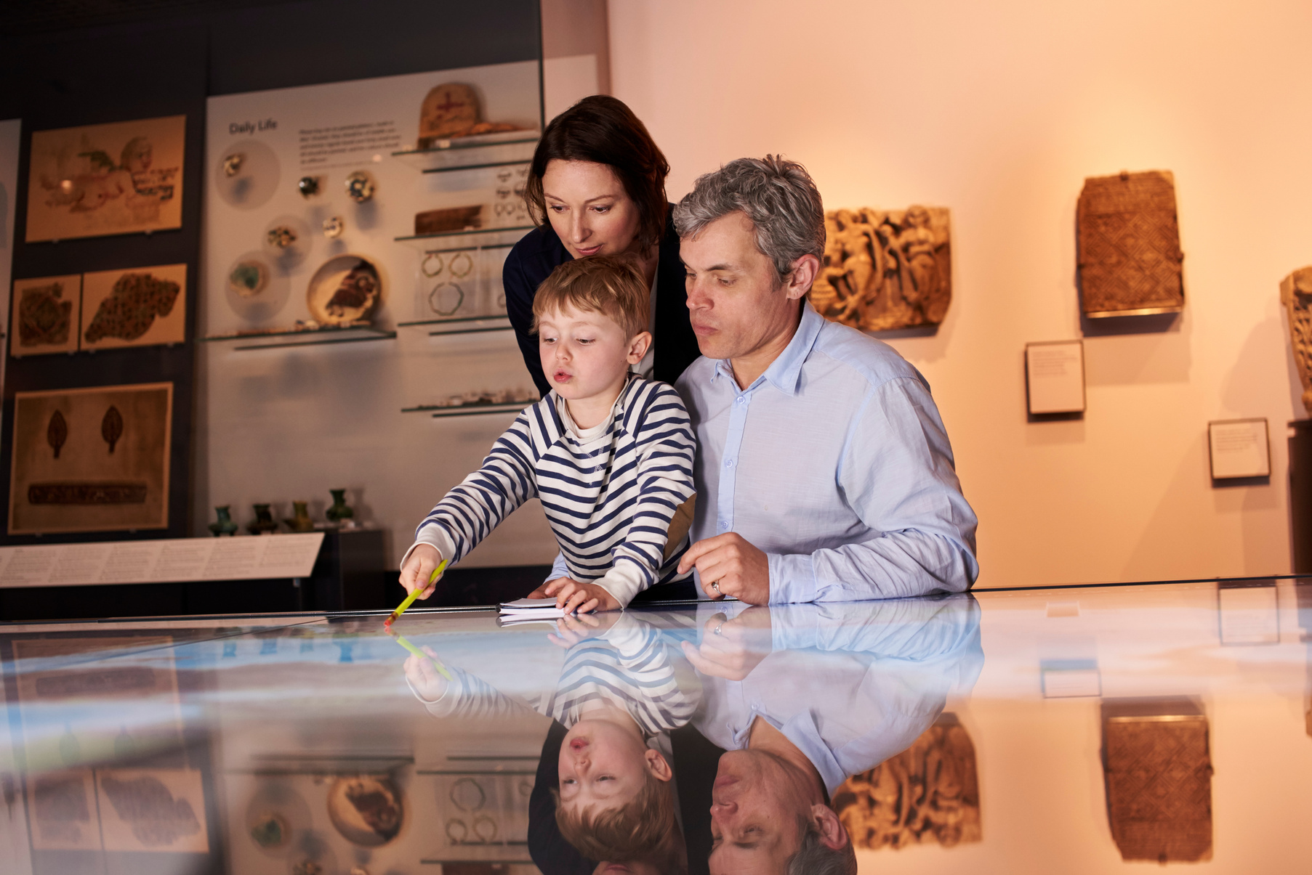
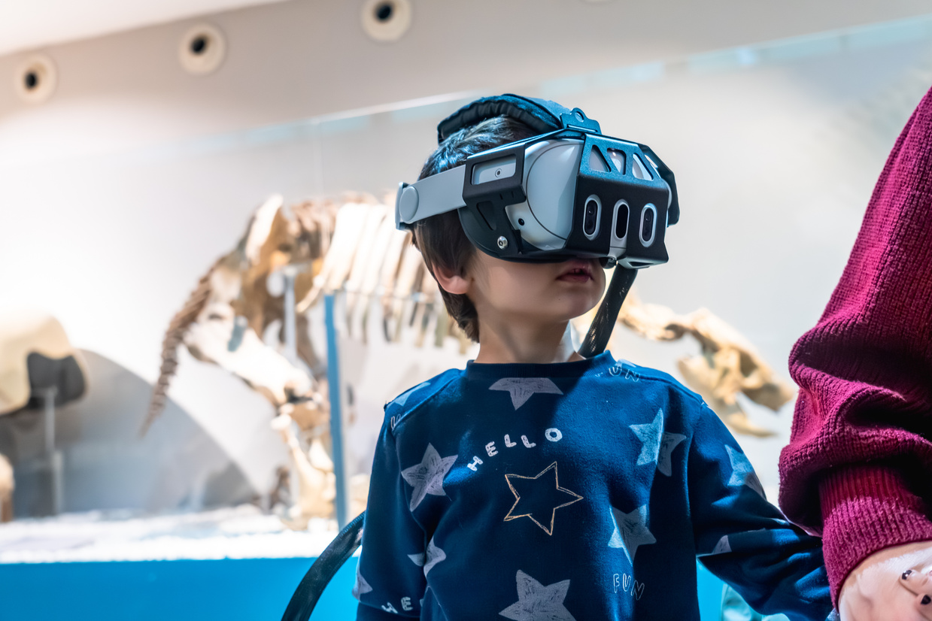
25-26J-416
03/16
Problem Statement & Stakeholders
Context
Observed Problem
Museums play an important role in informal education, helping visitors understand scientific and historical concepts through exhibits.
Many traditional museums rely on static displays and text-heavy explanations, which limit interaction and reduce engagement, especially for younger audiences.

Slide 5




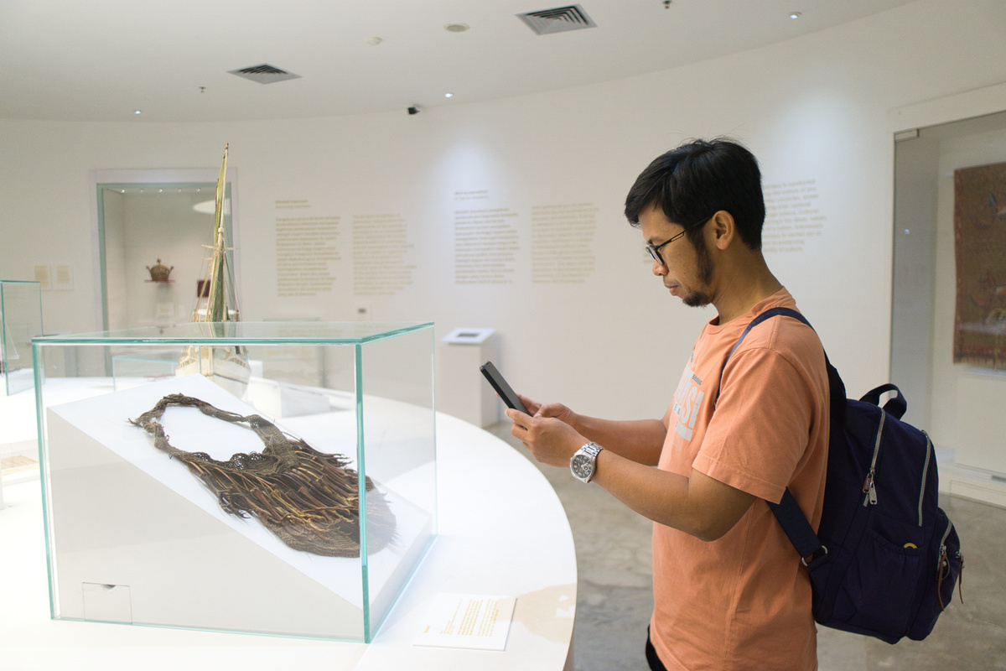
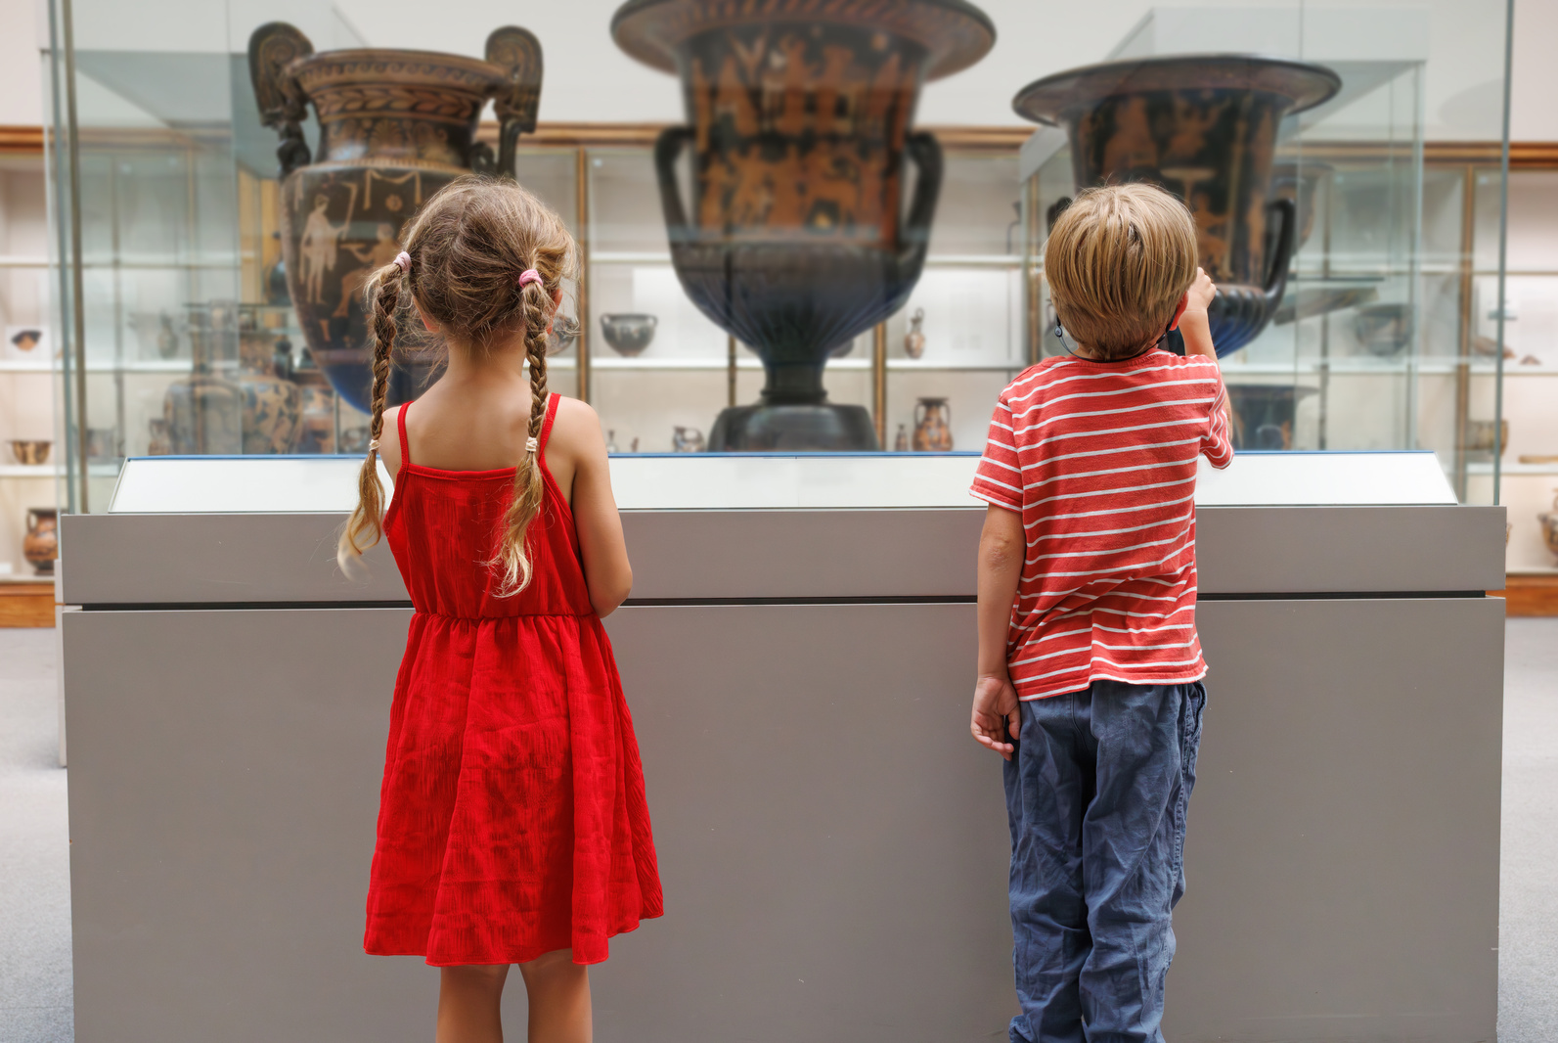

25-26J-416
04/16
Stakeholders
Primary Users
Secondary Users
Decision Makers
Museum visitors (students, families, researchers)
Museum educators and curators
Museum administrators
Why
It Matters
Reduced engagement
Lower educational retention
Limited accessibility for diverse audiences

Slide 6







25-26J-416
05/16
Research Gap & Objective
Gap
Although AR and VR technologies have been used in museum education, most existing solutions focus only on presenting information rather than supporting interactive learning and critical thinking.
Objective
Develop an AI-powered immersive museum platform combining AR and VR technologies to enhance visitor engagement and educational accessibility.

Slide 7
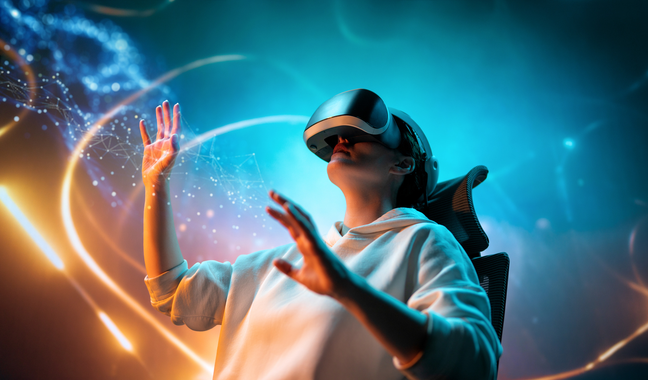
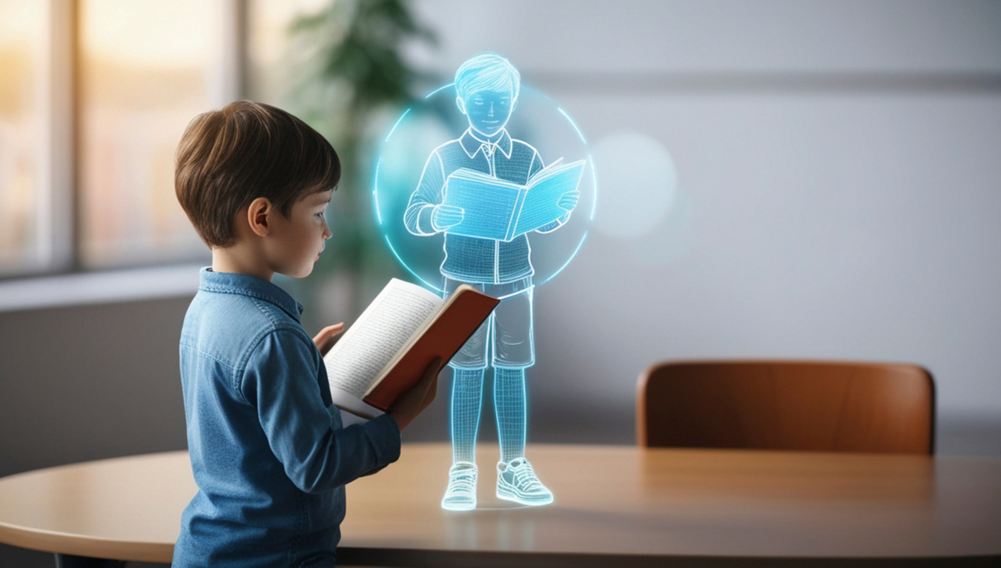


25-26J-416
06/16
Proposed Solution Overview
Solution Overview
An integrated AI-driven immersive platform combining AR mobile guides, VR excavation simulations, geological AR learning, and a multiplayer VR museum to transform traditional museum visits into interactive experiences.
Key Features
FR1 – AI-powered AR museum guide
FR2 – VR fossil excavation simulation
FR3 – Geological history AR exploration
FR4 – Multiplayer VR museum experience
Non-Functional Focus
Usability
Real-time rendering performance
Accessibility
Scalability

Slide 8
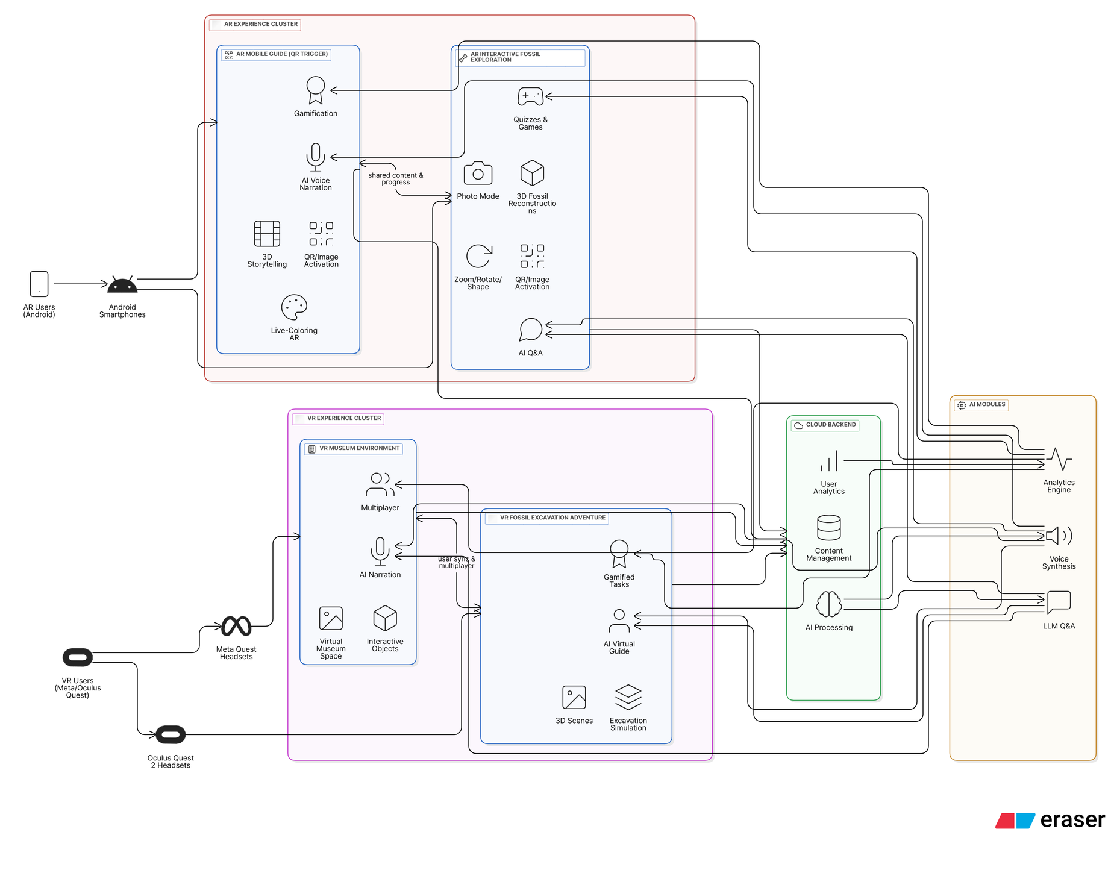
System Architecture & Integration
07/16

Slide 9







25-26J-416
08/16
System Components
Virtual Fossil Excavation Adventure (VR)
Interactive AR Mobile Guide with AI Voice Narration
Ashen
Tennakoon
Imalki Pinto
Interactive AR Exploration of Earth’s Geological History
VR Museum with Jungle Simulation
Ruwani
Pradeepa
Sherwin Li

Slide 10
25-26J-416
05/16
Comments from PP2 and Actions Taken
IT Number | Comments from PP2 | Actions Taken
IT22361004 | No Comments.
IT22149558 | Sinhala Voice is Good, AR optimization must be there | Compressed textures for mobile performance. Optimized animations for smoother rendering. Reduced unnecessary real-time lights. Improved object culling for hidden objects. Optimized AR scene loading speed.Made the quiz dynamic and UI enhancements
IT22135520 | Sinhala Voice must be more claer | Used Google Gemini API fro TTS and STT
IT22033482 | AR Optimization needed | Reduced the polygon count of the assets, enabling the AR scenes to be more responsive. Updated ARloopa WebAR for better performance. Randomized the Quiz questions on each try.

Slide 11


25-26J-416
09/16
IT22361004
Component 1
Virtual Fossil Excavation Adventure (VR)
Core Technologies
VR Engine: Unity 3D with OpenXR
Hardware: Oculus Quest 2 / 3
Physics: Realistic soil deformation & artifact interaction
AI Tutoring: Real-time guidance and feedback
Gameplay Mechanics
Tool Selection: Use brush, pick, or chisel for excavation
Stratified Excavation: Dig through geological layers to discover fossils
Achievement System: Earn badges for excavation techniques and species identification
Multiplayer Mode: Collaborate or compete in excavation activities
Impact
Provides hands-on paleontology learning through immersive VR, turning passive observation into interactive skill-based exploration.

Slide 12
25-26J-416
10/16
IT22149558
Component 2
Interactive AR Mobile Guide with AI Voice Narration
Core Technologies
AR Framework: Unity AR Foundation + Vuforia
Platforms: Android (ARCore) & iOS (ARKit)
3D Assets: Photogrammetry-based fossil reconstructions
AI Voice: Google Cloud TTS + LLM-based narration
Key Features
QR-Triggered AR: Scan QR codes to view 3D fossil models
Adaptive Narration: AI explains fossils in the user's language and level
Gamification: Quizzes, badges, and interactive challenges
Accessibility: Adjustable text, speech speed, color-blind friendly UI
Impact
Transforms static museum exhibits into interactive learning experiences, improving engagement and supporting multilingual audiences.

Slide 13
25-26J-416
11/16
IT22033482
Component 3
Interactive AR Exploration of Earth’s Geological History
Core Technologies
AR Tracking: Marker & image recognition (Vuforia)
Platforms: Mobile AR (Android)
Color recognition
AI Narration: Storytelling
Key Features
Coloring-to-AR: Color drawings and watch them animate in AR
Interactive Quizzes: Adaptive questions based on user performance
Narrative Exploration: Learn about Paleozoic, Mesozoic, and Cenozoic eras
Device Optimization: Runs smoothly on budget smartphones
Impact
Connects physical coloring activities with AR storytelling, encouraging creativity and helping children learn geological history in an engaging way.

Slide 14
25-26J-416
12/16
IT22135520
Component 4
Multiplayer VR Museum with Jungle Simulation
Core Technologies
VR Engine: Unity 3D with OpenXR
Networking: Photon PUN 2 (multiplayer system)
Hardware: Oculus Quest 2 / 3
AI Voice Assistant: LLM-based avatar for natural language interaction
Key Features
Virtual Museum Galleries: Interactive fossil exhibits and information panels
Jungle Simulation: Prehistoric environments with animated creatures
Multiplayer Interaction: Avatars collaborate and explore together
Voice Commands: Ask questions and receive AI-generated explanations
Impact
Connects physical coloring activities with AR storytelling, encouraging creativity and helping children learn geological history in an engaging way.

Slide 15
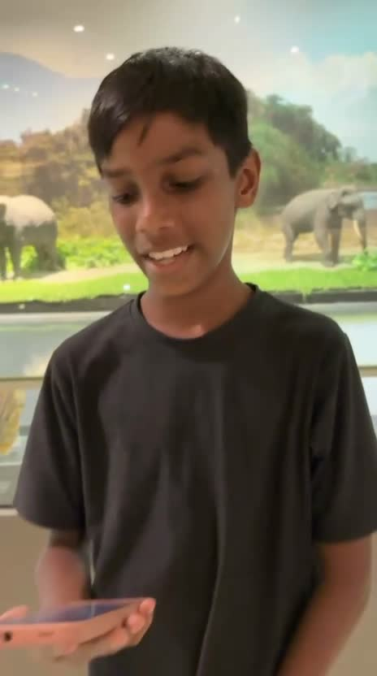
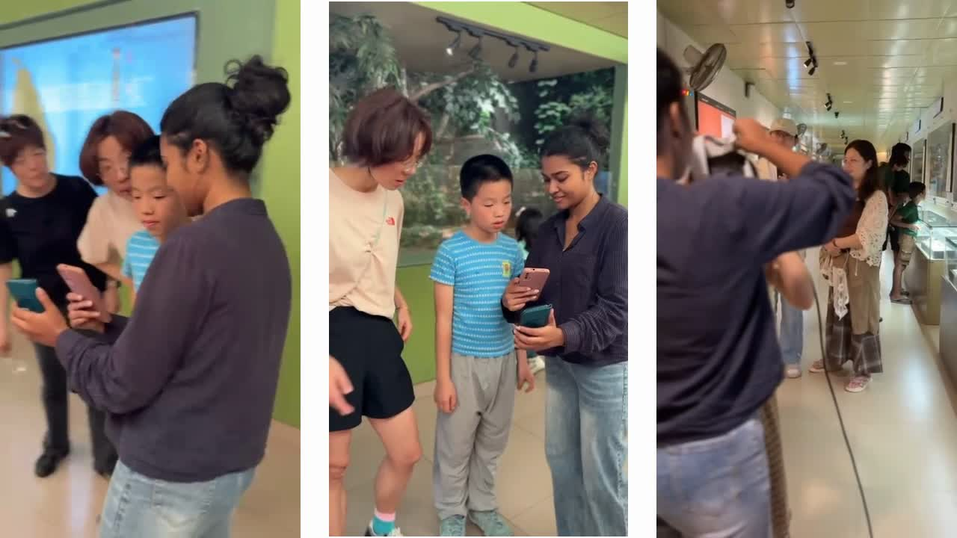
25-26J-416
13/16
Results and Testimonials

Slide 16
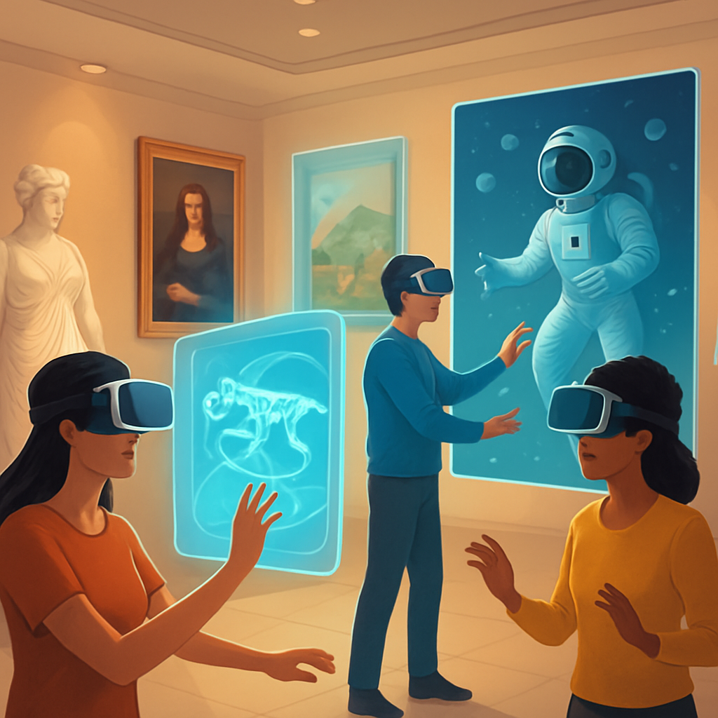
25-26J-416
16/16
Benchmark Results
Limitations of the System
Requires specific hardware (e.g., capable smartphones or VR headsets)
AI responses may vary based on internet connectivity
Expanding the fossil/artifact database
Expanding the fossil/artifact database
Integration with museum ticketing or visitor tracking systems

Slide 17
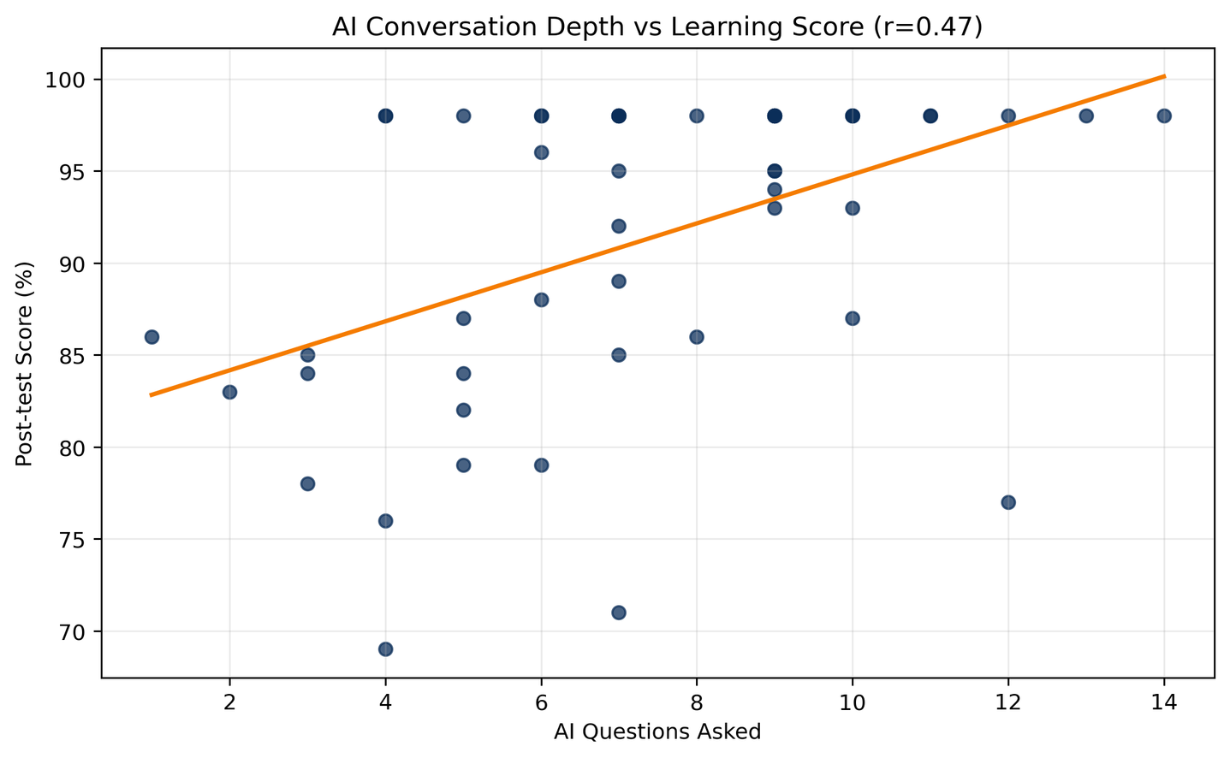
25-26J-416
16/16

Slide 18
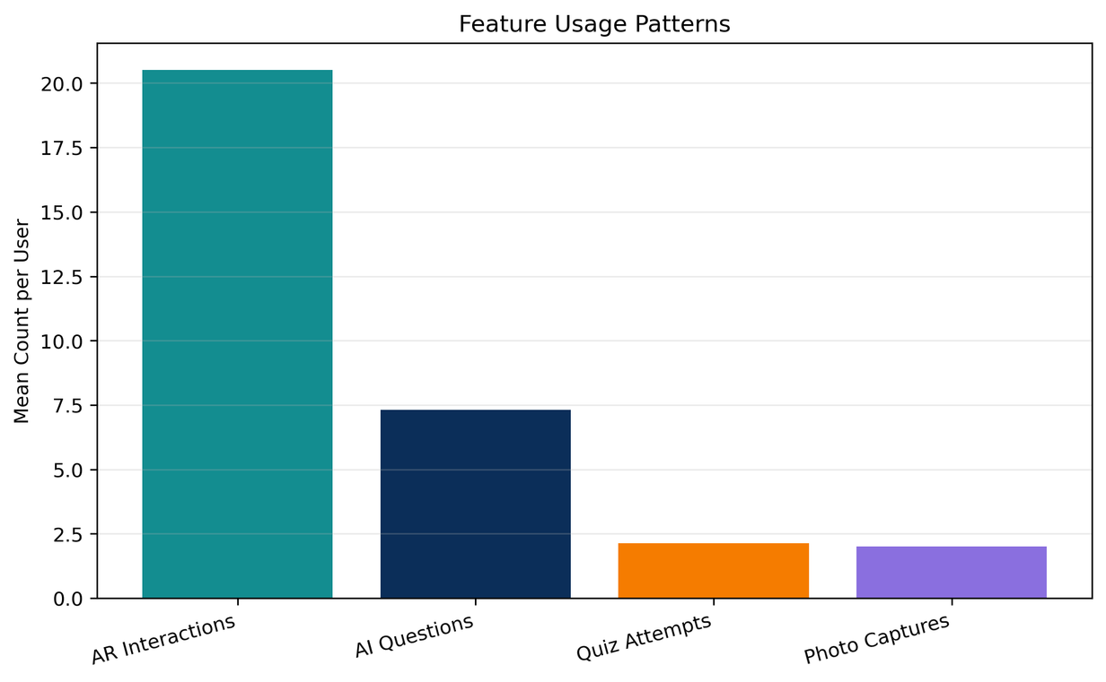
25-26J-416
16/16

Slide 19
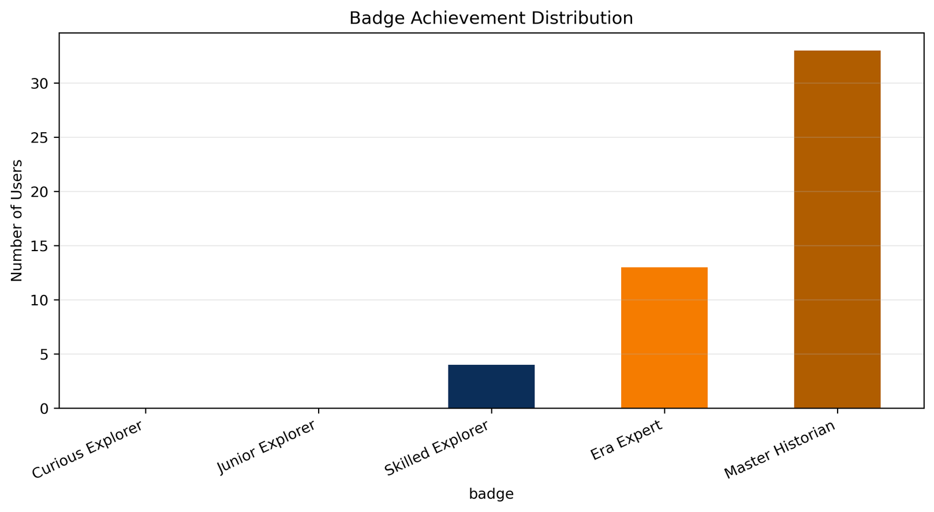
25-26J-416
16/16

Slide 20
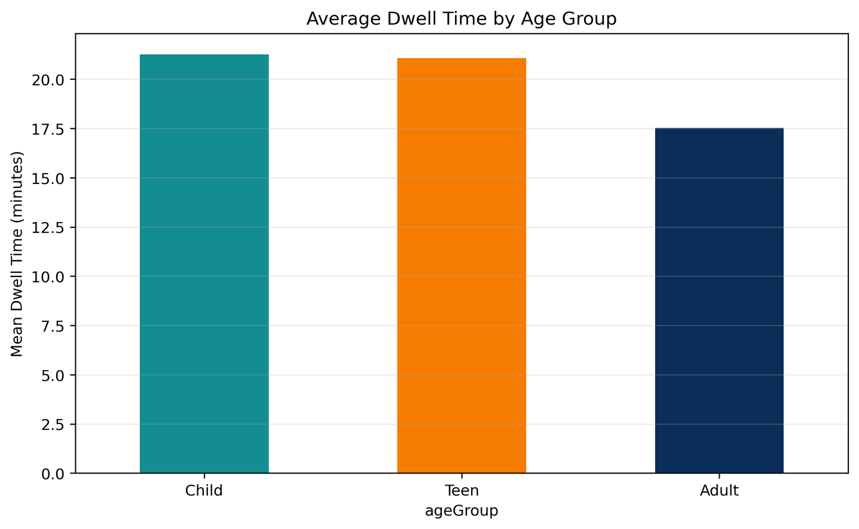
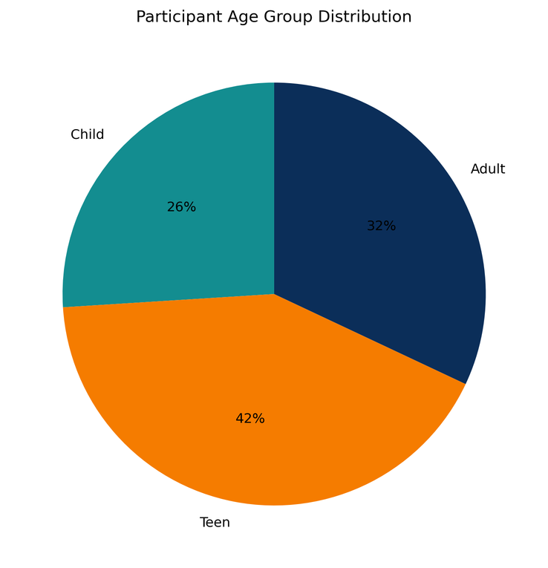
25-26J-416
16/16

Slide 21
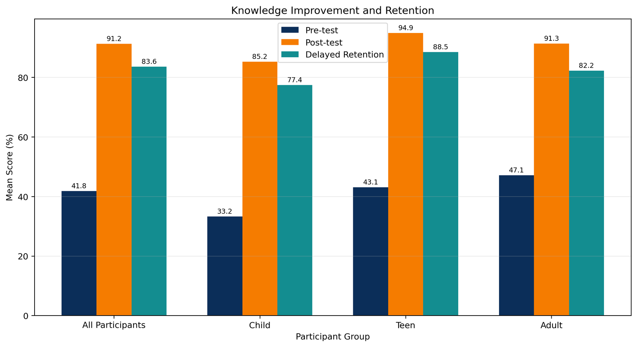
25-26J-416
16/16

Slide 22
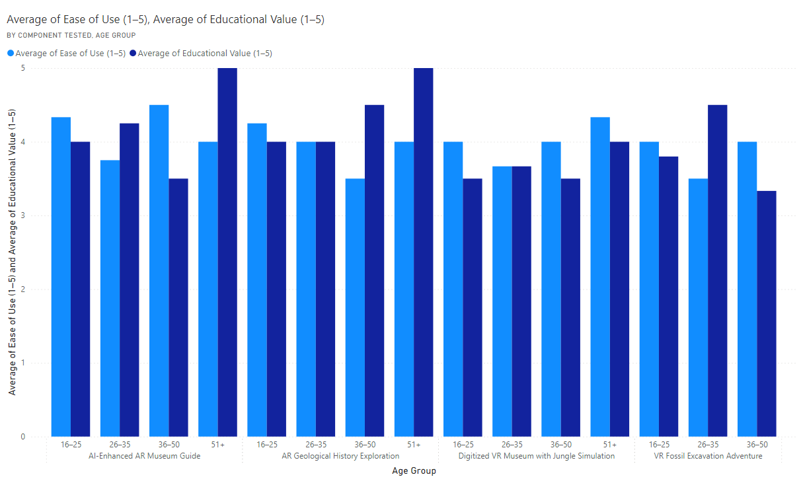
25-26J-416
16/16

Slide 23
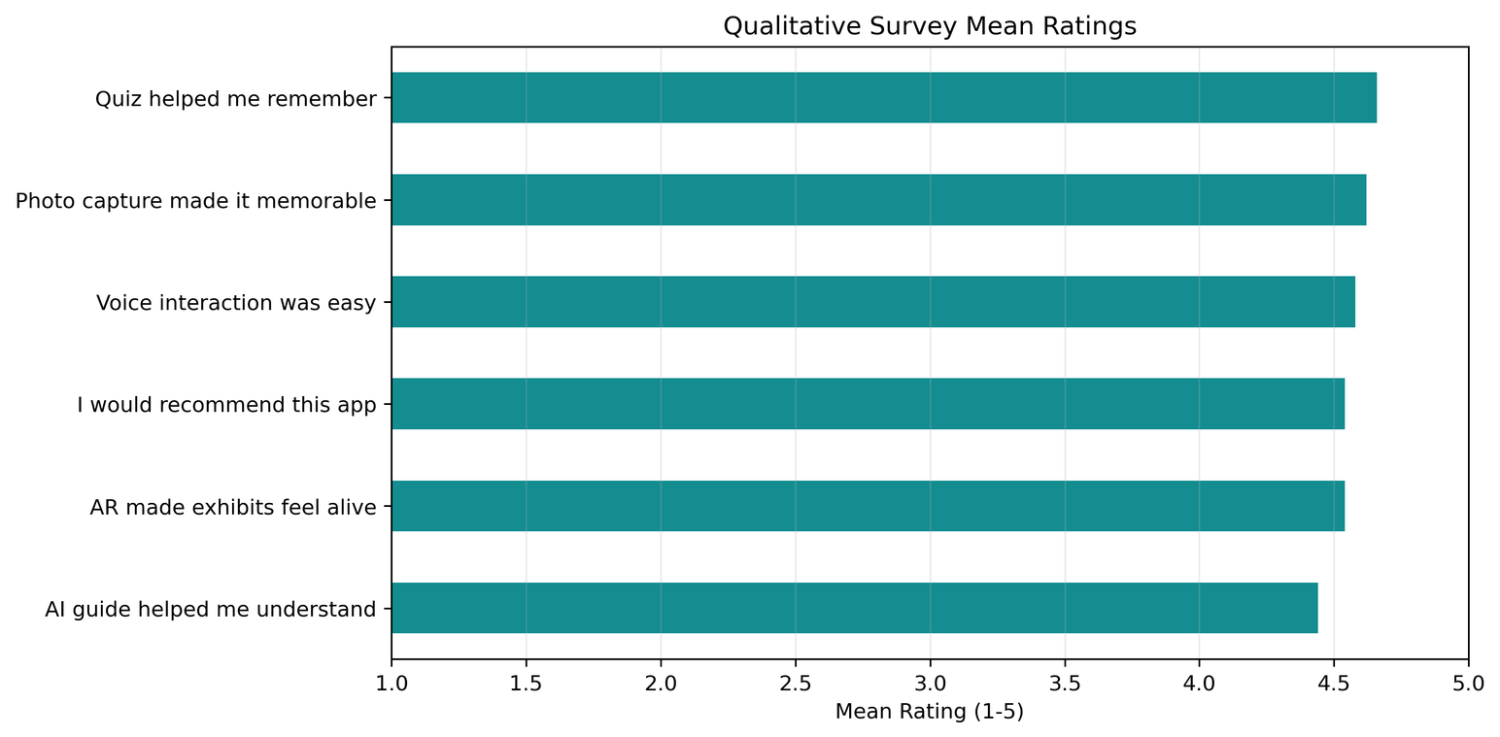
25-26J-416
16/16

Slide 24

Thank you!

